Slide 1


Ondokuz Mayıs University
You are all very Welcome

Slide 2

Higher Education in Turkey
207 Higher Education Institutions (HEIs)
All managed by the Council of Higher Education, not by the Ministry of Education.

Slide 3
Types of Higher Education Institutions in Turkey
State Universities
Higher Vocational Schools
Private or Foundation Universities
Other Higher Educational Institutions (eg. Police Academy)

Slide 4
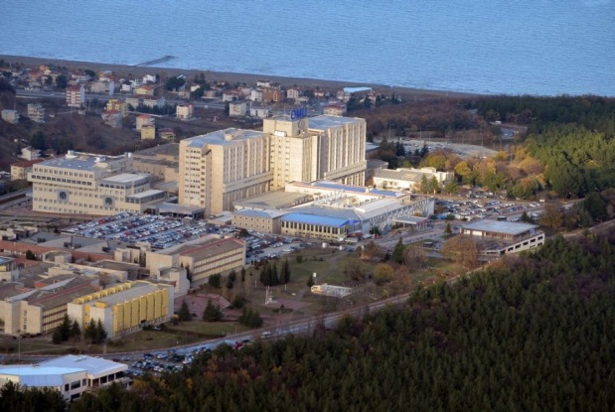
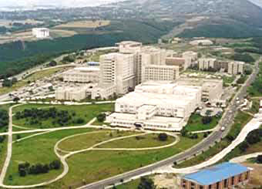
Location of Ondokuz Mayıs University
Ondokuz Mayıs University is located in Samsun, the largest city in the Black Sea Region of Turkey
The university has schools in Samsun and 7 other counties.

Slide 5

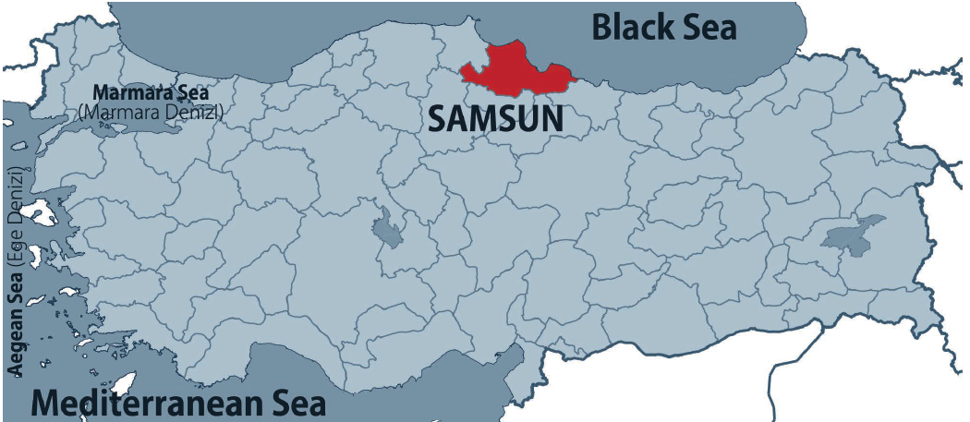

Location

Slide 6
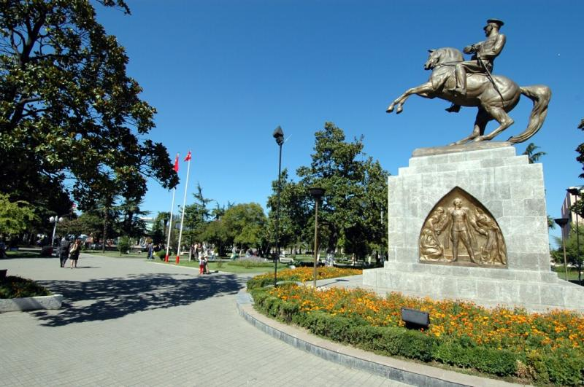
SAMSUN
Samsun is the main and largest Metropolitan city of the Black Sea Region with a population of 1.3 million and it is the trade, industry, finance and health center of the region.

Slide 7
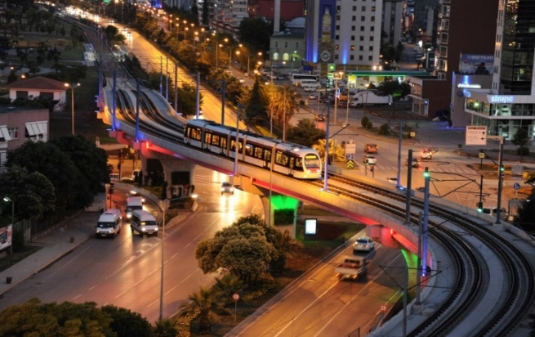
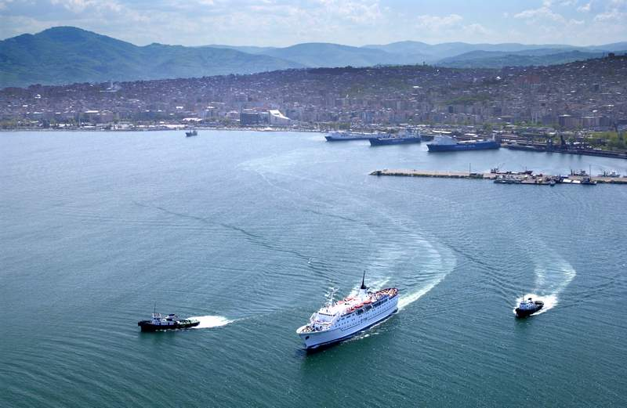
SAMSUN
Samsun is one of the four cities in Turkey which has a consolidated transport infrastructure: airway, railway, overland route and sea route.
It is an energy (natural gas) station: Blue Stream Natural Gas Pipeline and Samsun Ceyhan Oil Pipeline

Slide 8
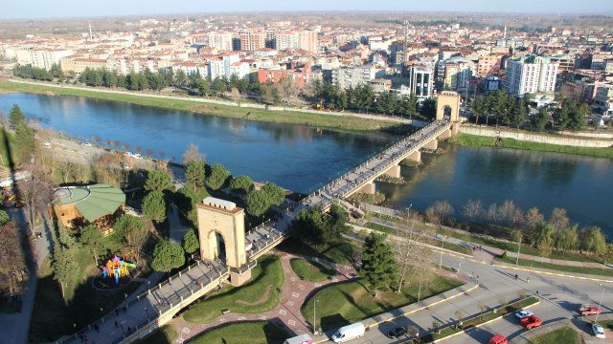
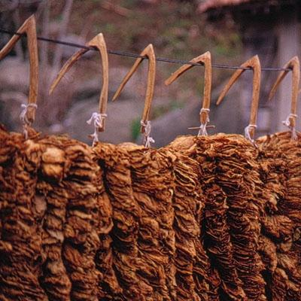
SAMSUN
Samsun is also an important agricultural centre with its fertile Bafra and Çarşamba Plateaus and the 2 Rivers Yeşilırmak and Kızılırmak.
Primarily tobacco, hazelnuts, wheat, rice, sugar beet, corn, other nuts, sunflower, fruits and vegetables and various kinds of agricultural goods are grown in these lands.

Slide 9
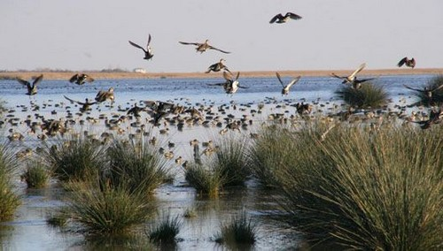
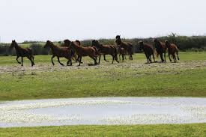
SAMSUN
The Kızılırmak Delta is considered to be one of the most important bird wildlife habitats (352 bird species) in the world.

Slide 10
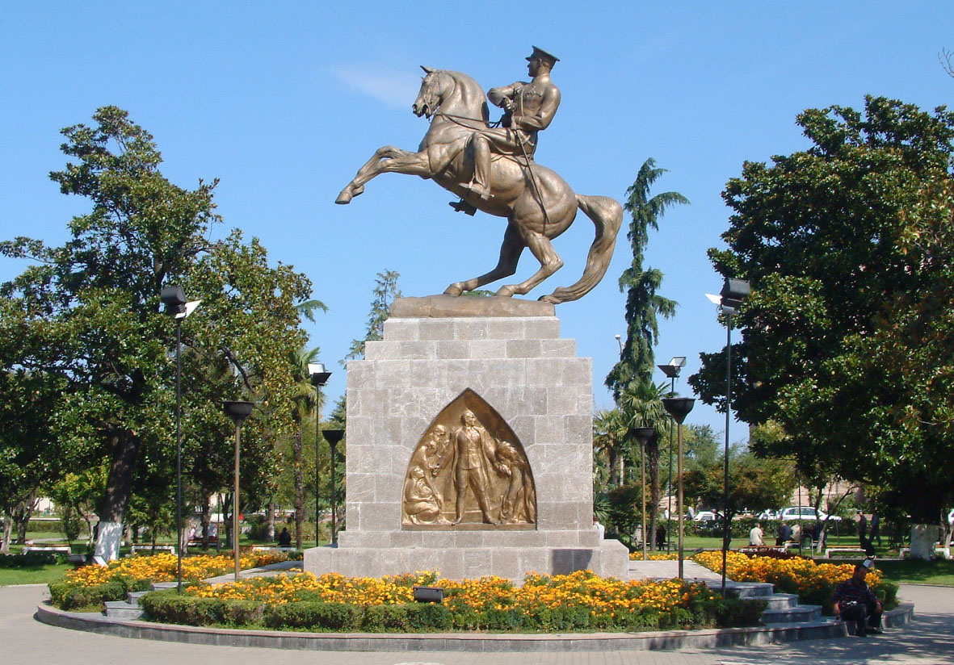
SAMSUN
The founder of the Republic of Turkey, Mustafa Kemal Atatürk initiated the “War of Independence” on 19 May 1919 in Samsun. Because of this, Samsun is also called the “City of Ondokuz Mayıs”.

Slide 11
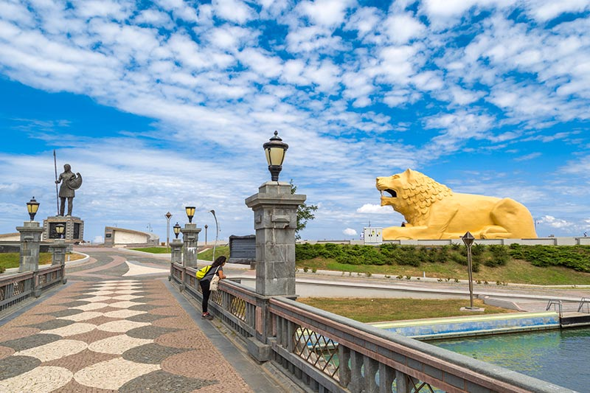
Samsun also famous for….
History that dates back to 7th Century B.C
Legend that the Amazons lived in Terme, Samsun
Thermal springs in Havza and Ladik
Annual International Folk Dancing Festival
Samsun “Pide” and “Simit”

Slide 12

Samsun also has a very mild climate and l can say that the coldest it can get in Winter is 3ºC during the day. It has a lot of sunshine and it is possible to go for a walk in the beach even in winter.

Slide 13
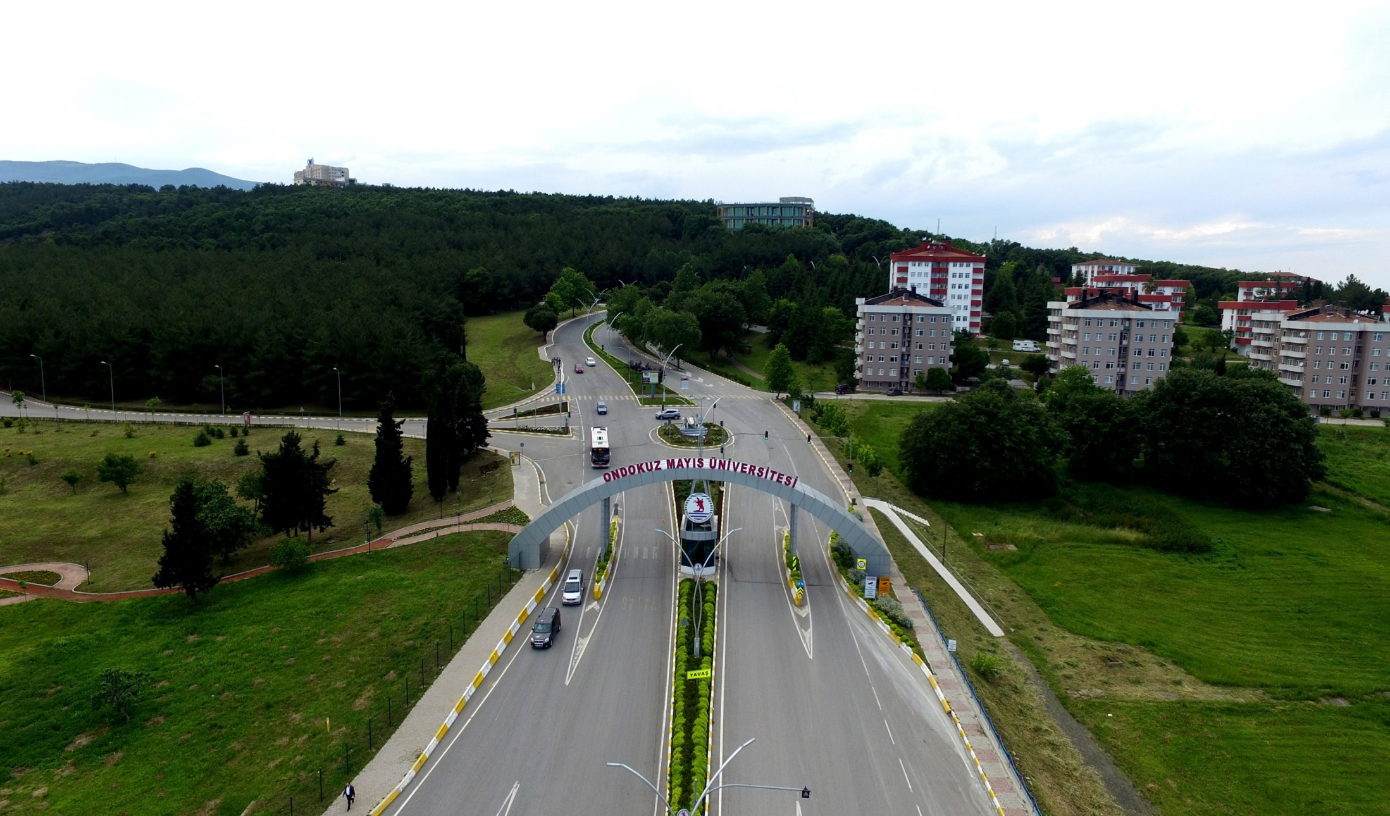

Slide 14
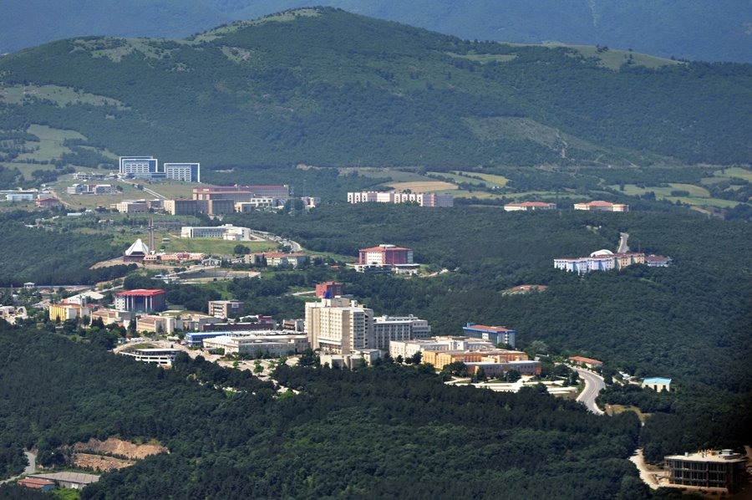
About OMU…..
Ondokuz Mayıs University is a state university founded in 1975 in Samsun.
Ondokuz Mayıs University is one of the leading universities in Turkey in terms of staff quality and number, academic and social facilities and infrastructure. Regarding accommodation, transportation, sports facilities, cultural and social environment, our university provides a happy and productive environment to both students and staff.

Slide 15
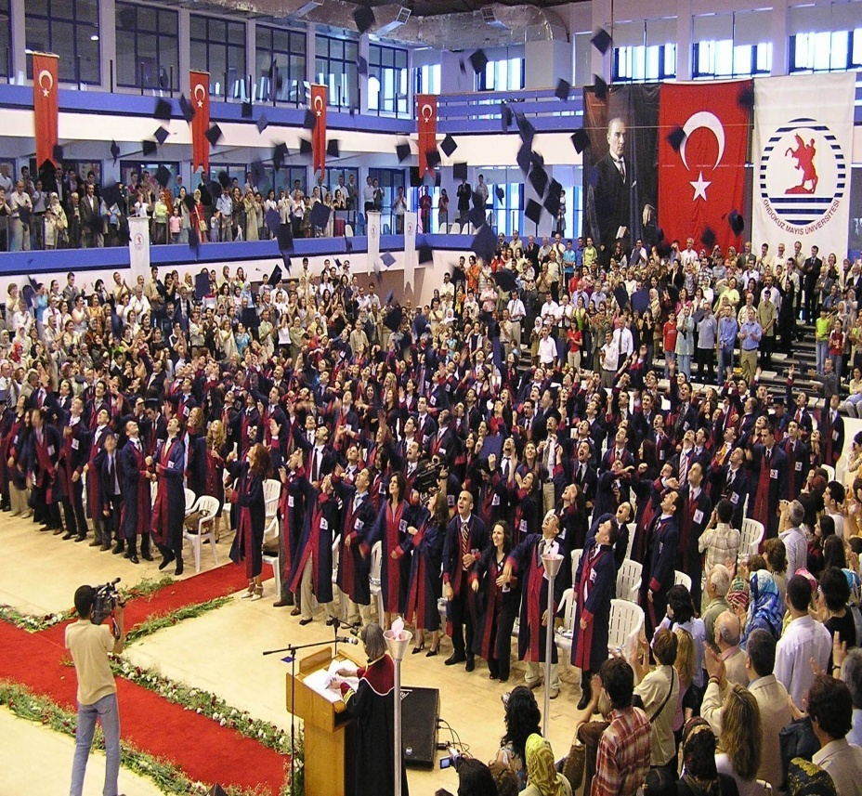
Ondokuz Mayıs University Today
19 Faculties
1 Conservatoire
1 Colleges (First Cycle)
12Vocational schools (short cycle)
2 Graduate Schools
28 Research Centres

Slide 16
Ondokuz Mayıs University in figures…
Number of students (including: virtual studies, Masters and Postgraduate students) : approx. 52,640
Number of academic staff: approx. 2,307
Number of administrative staff: approx. 4,330
Number of International Students: approx. 4,620
Number of Exchange Students: approx. 25
Number of Different Countries: approx. 104

Slide 17
Faculties
Ali Fuad Başgil Faculty of Law
Çarşamba Faculty of Humanities and Social Sciences
Faculty of Dentistry
Faculty of Pharmacy
Faculty of Education
Faculty of Science
Faculty of Fine Arts
Faculty of Economics and Administrative Sciences
Faculty of Theology
Faculty of Communication
Faculty of Humanities and Social Sciences
Faculty of Architecture
Faculty of Engineering
Faculty of Health Sciences
Faculty of Medicine
Faculty of Tourism
Faculty of Veterinary Medicine
Yaşar Doğu Faculty of Sport Sciences
Faculty of Agriculture

Slide 18

University Facilities (1/2)
1 guesthouse
1 hotel
1 swimming pool of Olympic standards
1 diving pool
5 multi functional indoor sport halls
4 football grounds
3 tennis courts
Sport and fitness centre including a spa, sauna, fitness equipment, canteens, etc
Kindergarten/primary and secondary school
Observation house
Planetarium

Slide 19
University Facilities (2/2)
Art gallery
Botanical garden
Conference halls
Libraries
Computer laboratories
Canteens, cafeterias, restaurants, etc
An artificial Climbing wall
Natural mountains and rocks to climb

Slide 20
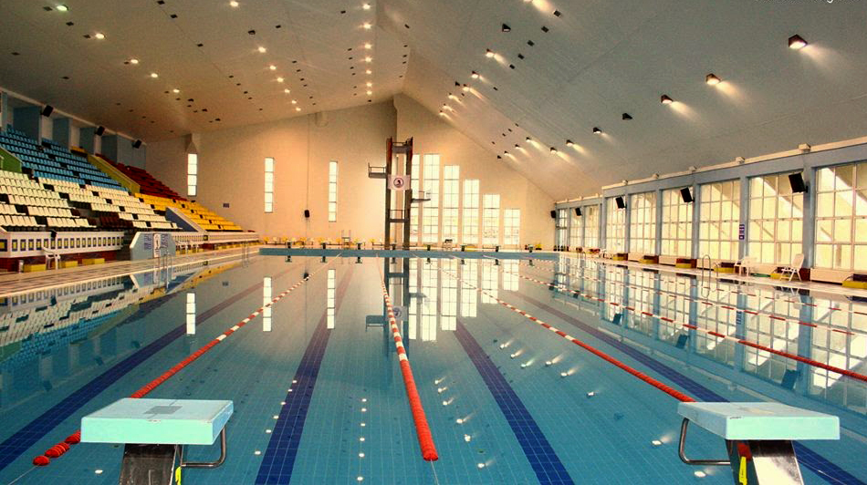
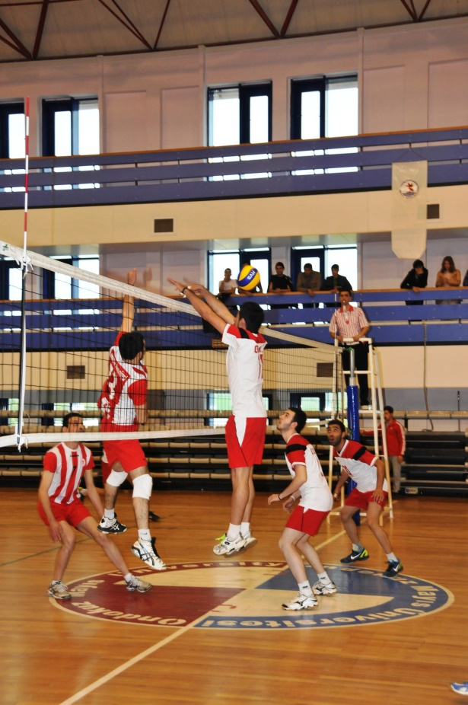

Slide 21
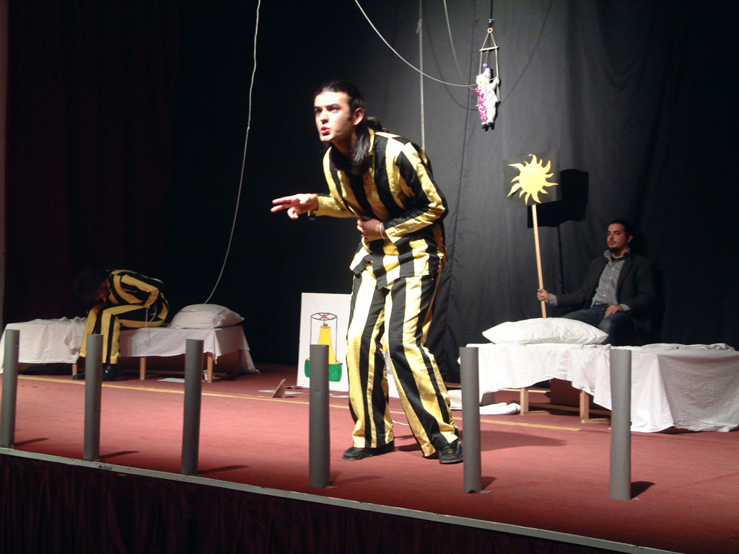
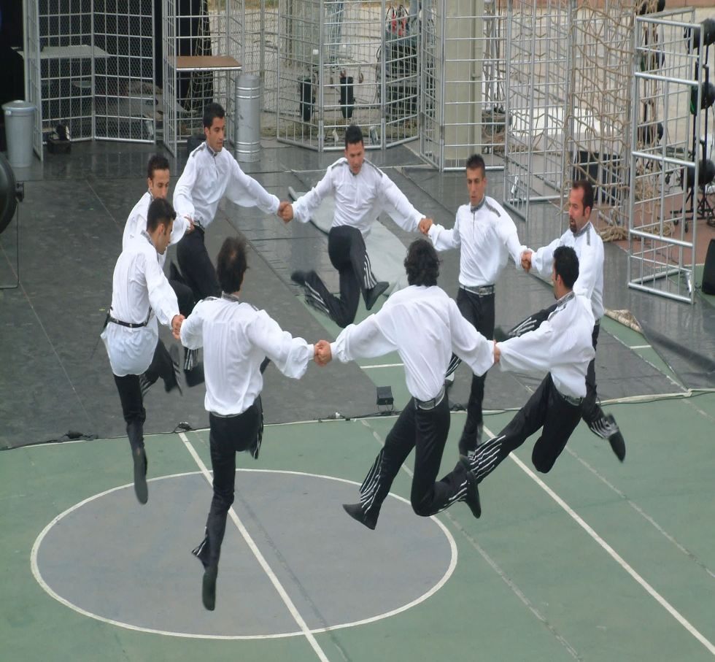
OMU Socially
OMU has 90 student clubs actively involved in various fields of sport, music, theatre, nature and science. Some of these clubs are;
Mountaineering and Winter Sports, Science and Research, Poetry, Photography and Travelling, Ecological Living and the Rock Club.

Slide 22

International Cooperation
Erasmus+ KA 131 | 343 Inter-institutional Agreements with 25 different countries
Erasmus+ KA 171 | (120 Partner Countries Agreements with 18 different countries)
MOUs | 185 Protocols with 46 different countries
TR Mevlana Programme | 66 Mevlana Protocols with 25 different countries
International Students | 4,620 International Students from 104 different countries
International Programmes | Medicine, Economics, Material Sciences and Engineering, Nanoscience and Nanotechnology

Slide 23
Study Areas & Language of Instruction:
Medicine (English)
Economics (English)
English Language Teaching (English)
Material Sciences and Engineering (30% English, 70% Turkish)
Department of Horticulture (Master’s - English)
Other undergraduate programs are primarily in Turkish, but exchange students are supported with English materials, tutorials, and exams.
At the graduate (Master’s and PhD) level, programs are available in both Turkish and English.

Slide 24
Thank you!

